Slide 1
EFFECTIVE PATTERN DISCOVERY FOR TEXT MINING
INTERNAL GUIDE:
MS.G.SUMALATHA
GROUP MEMBERS:
K.SAI SURAJ-11311A1279
V.SHESHU KUMAR-11311A1278
V.VAMSHI KRISHNA-11311A1A1
S.VIVEK ROSHAN-11311A12A8
PROJECT COORDINATOR:
MR. K. KRANTHI KUMAR

Slide 2
Contents:
Abstract
Project Overview
Project Scope
System Analysis
Project Architecture
Pattern Taxonomy Model (Algorithm)
Sequence Diagrams for project.
Screens
Planning

Slide 3
Abstract:
Many data mining techniques have been proposed for mining useful patterns in text documents. However, how to effectively use discovered patterns is still an open research issue, especially in the domain of text mining.
Since most existing text mining methods adopted term-based approaches, they all suffer from the problems of polysemy and synonymy.
polysemy means a word has multiple meanings, and synonymy is multiple words having the same meaning.

Slide 4
Project overview:
Many types of text representations have been proposed in the past.
This project presents an effective pattern discovery technique, which first calculates discovered specificities of patterns and then evaluates term weights according to the distribution of terms in the discovered patterns rather than the distribution in documents for solving the misinterpretation problem.

Slide 5
Project scope:
To provide maximum services to the user
Fast response
Facilitate for maintenance of any data
To reduce the memory overhead
Most relevant and accurate results

Slide 6
System analysis:
User friendliness with correct response
System makes the overall data to be maintained in a specified format
There is no risk of data mismanagement at any level

Slide 7
Project Steps
Start
1.Uploading a File from a database of different files.
2.Assign the terms to the paragraph set ( dp1,dp2 )
3.Divide the terms using a Delimiter ( “ , “ )
4. Provide a minimum support.
5. Process the Algorithm with the assigned terms.
6.Process the terms with the Algorithm ( Pattern Taxonomy Model).
7.Generate the Frequent Item Set with their Support counts.
8.We optimize the terms within the processed Frequent Items.

Slide 8
9. Find out the partial and the complete trees.
10. Compare both partial and the complete trees.
11.Exit

Slide 9
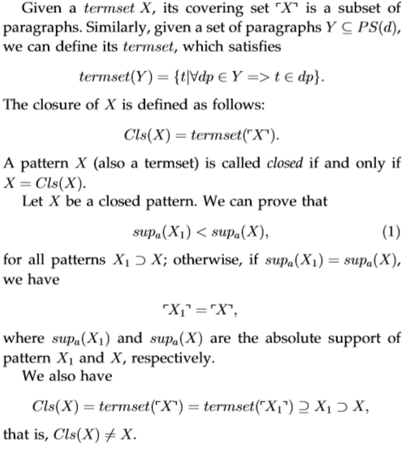
Pattern Taxonomy Model:

Slide 10
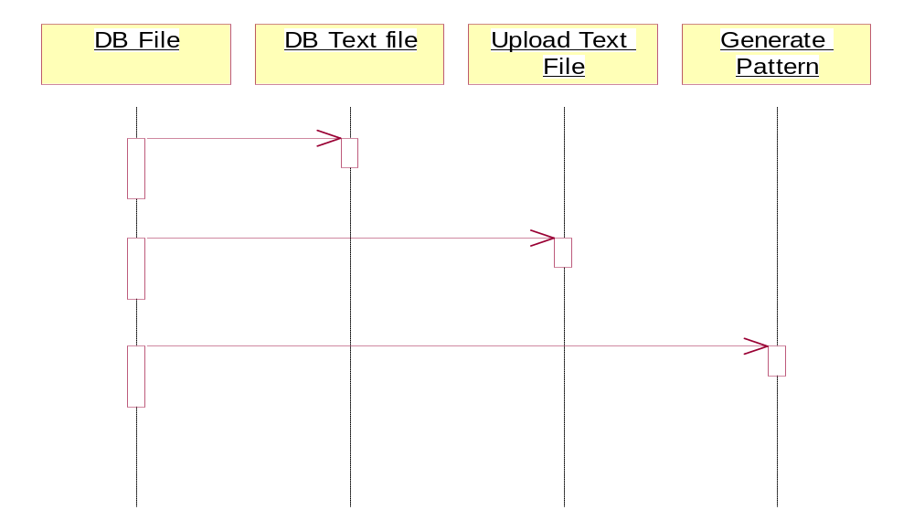
Project Sequence:

Slide 11
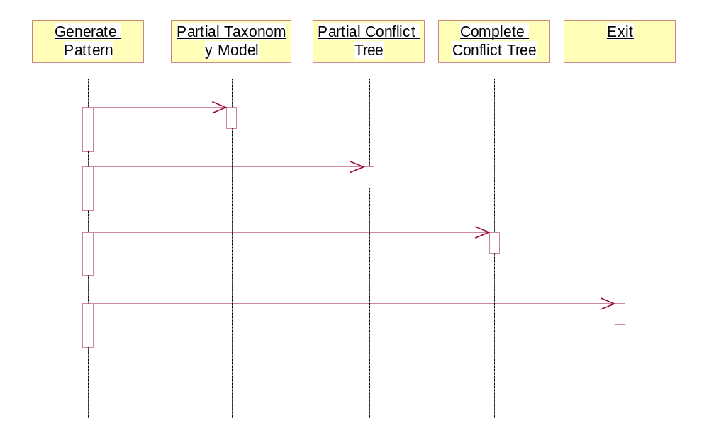

Slide 12
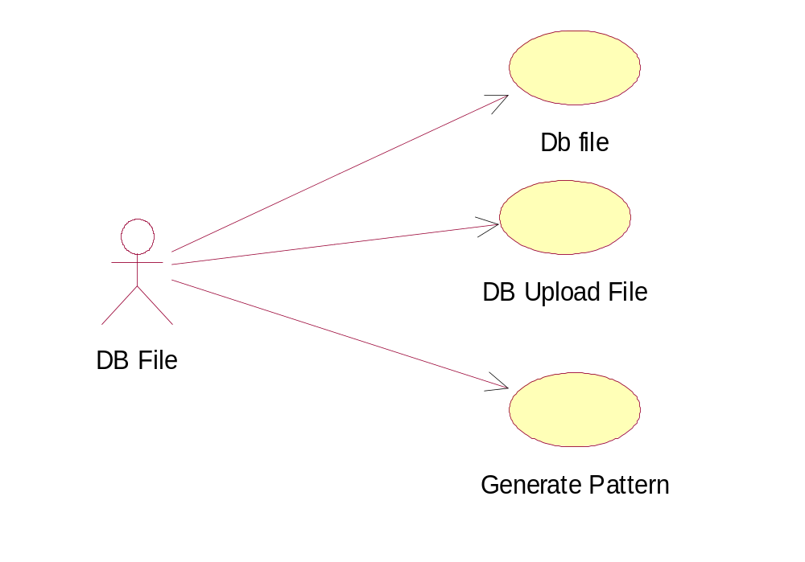
What we have done:

Slide 13
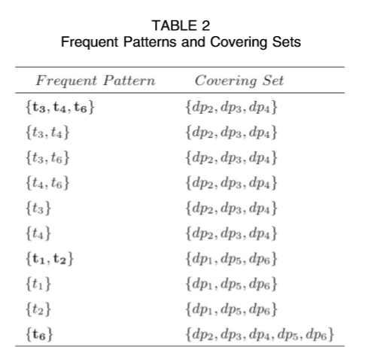
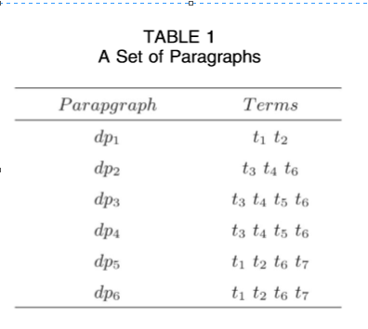
Example:

Slide 14
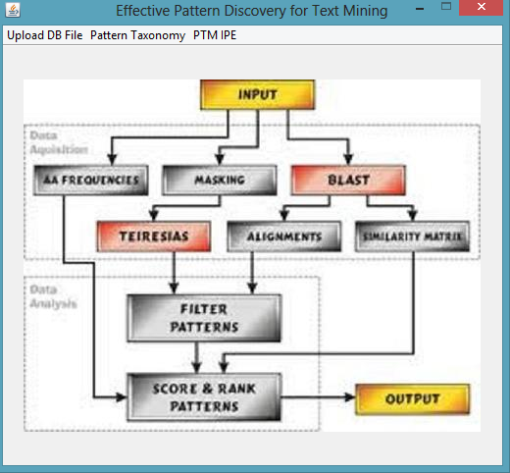
Screens:

Slide 15
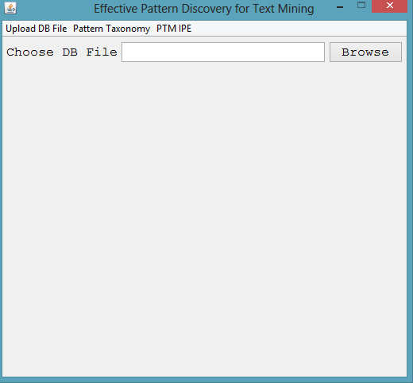


Slide 16
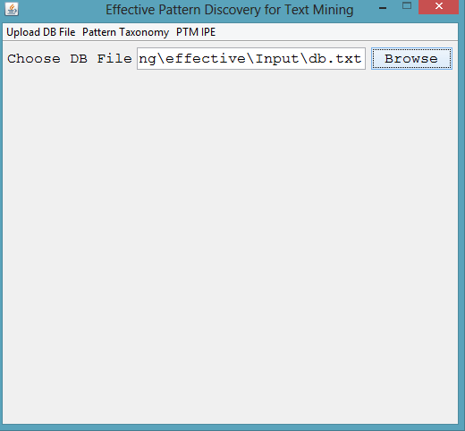

Slide 17
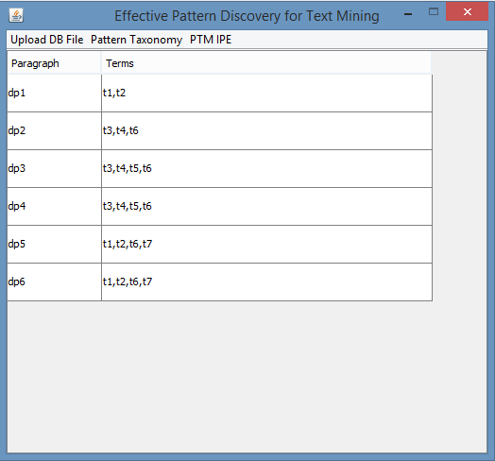

Slide 18
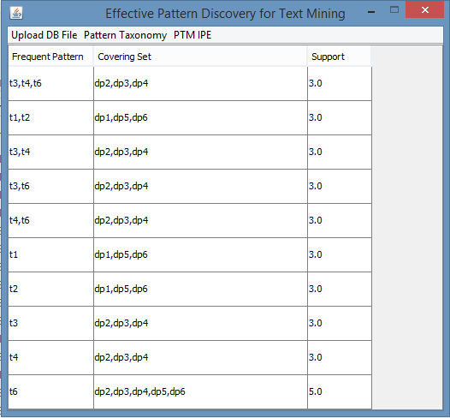

Slide 19
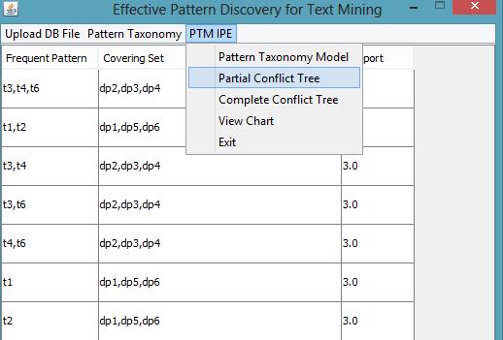

Slide 20
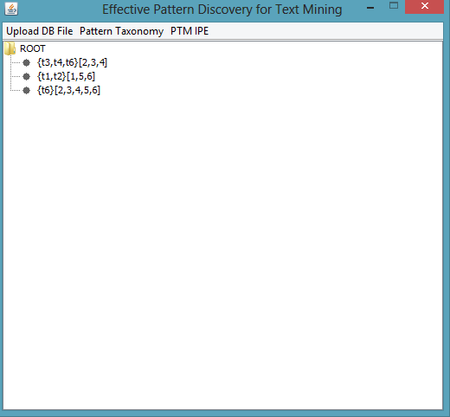

Slide 21
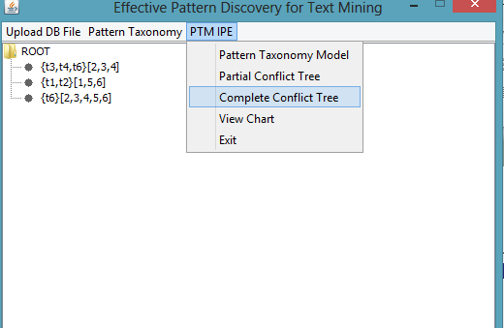

Slide 22
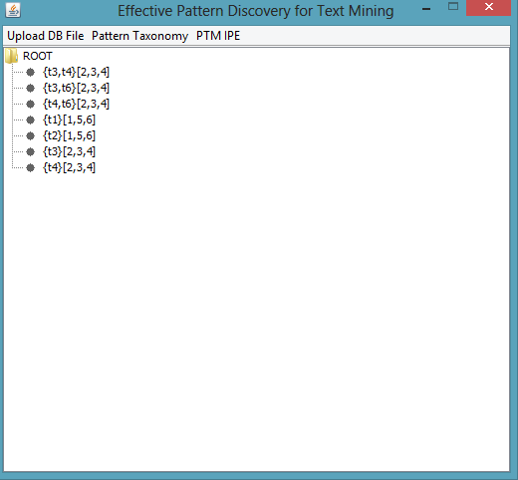

Slide 23
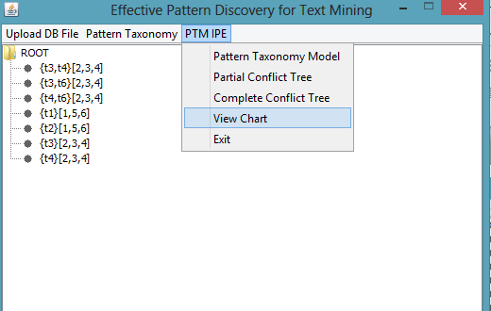

Slide 24
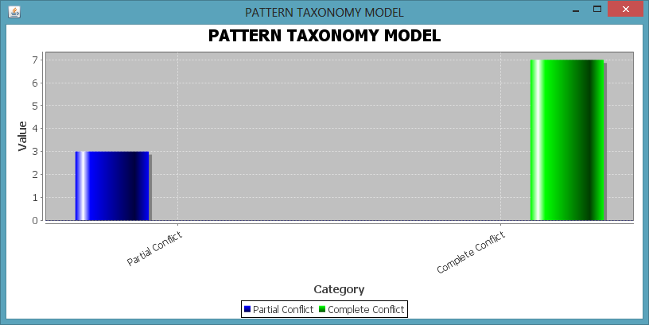

Slide 25
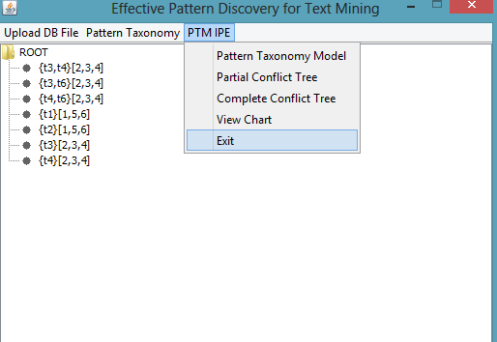

Slide 26
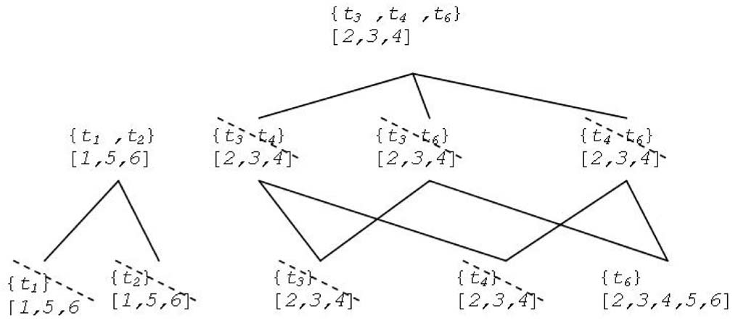
Planning :

Slide 27

For your time….

